Slide 1

FALL 2023
MIS 381N
Information management
Lecture 19
Oct 23rd 2023
Prashant D. Joshi
UT McCombs School of Business (MSBA), The University of Texas at Austin

Slide 2

Objectives
0. Final Projects?
Kubernetes
Reference Architecture
Components
Deployment, PODs, Facilitating
Questions and discussion

Slide 3
What questions may I answer before we begin …
All questions are good questions

Slide 4
Housekeeping
Mid Term
Project progress?
Project reps: Can you give your team’s progress so far?
Assignment 4 due on Wednesday
New Assignment on Canvas (dealing with Kubernetes… so pay attention to class today!)
Made minor modifications to the class syllabus without getting rid of any basic topics… (ex: Kubernetes)

Slide 5
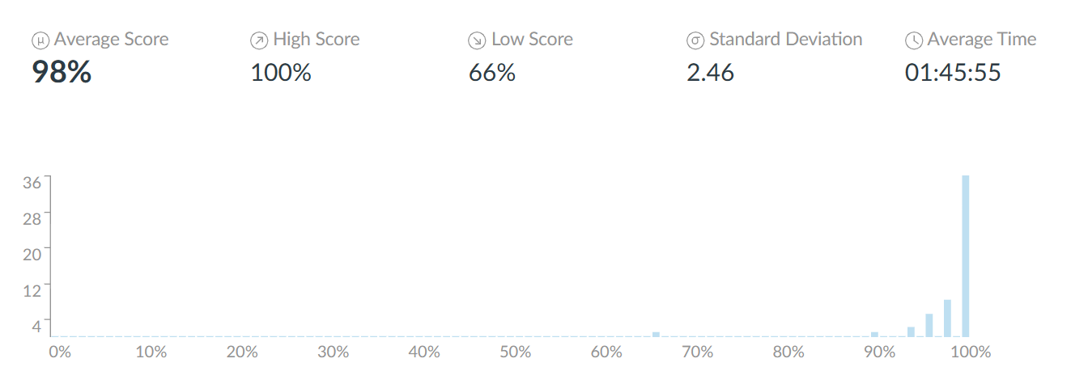
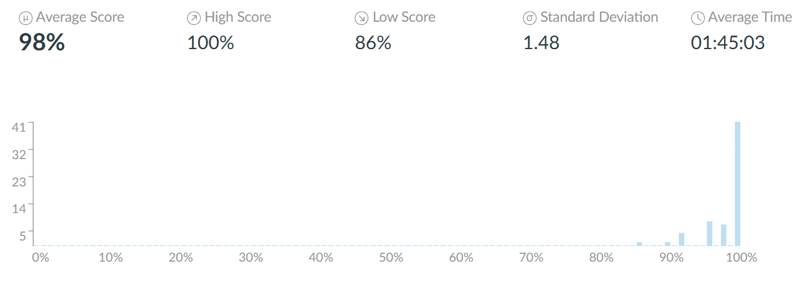
Mid term statistics

Slide 6
Kubernetes

Slide 7

What is Kubernetes?
Open-sourced container orchestration platform for automating, deploying, and managing containerized applications
Originally developed by Google
Impossible to manage thousands of containers by scripting
Well adopted in industry to enable scaling, resiliency, and efficient deployment of thousands of containers in various environments such as physical, virtual, or cloud machines using microservices

Slide 8
Container Orchestration?
Automated management, deployment, scaling, and operation of containerized applications.
These need overseeing and coordination for efficiency, reliability, scaling
Very high availability
Service deployment automation
Load balancing
Scaling
Self-healing
Resource Allocation
Security and Isolation
Challenges
Increased complexity
Needs expertise building
Network management
Resource and storage management
Security issues
Monitoring and debugging

Slide 9
Microservices?
Microservices is a software development approach where an application is structured as a collection of small, independently deployable services, that communicate through APIs
Decomposition
Independence
API interfaces
Scalable
Resilience
Technology Diversity
Monitoring
…
Challenges
Increased complexity
Inter-service communication
Service management
Careful planning
Strong and tested development and operation practices
Infrastructure support

Slide 10
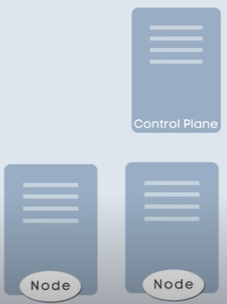

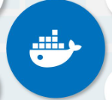
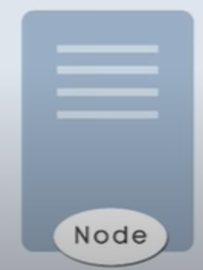

Kubernetes Architecture
Master Control Node
Multiple Worker Nodes (or just Nodes)
Each node has a kubelet process running on it to talk to each other and control and execute processes
Containers with different application tasks on the nodes
Docker is a popular tool for creating containers
https://www.youtube.com/watch?v=s_o8dwzRlu4

Slide 11
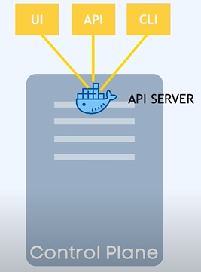



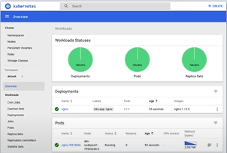

Kubernetes Architecture
Master Control Node
API server also a container acts as the entry point to the kubelets
Controller Manger to keep track of what's happening in the cluster
Scheduler decides on which nodes new Pods should be scheduled
Etcd for state of controller, key-value, backups to recover in case of catastrophic failures, etc

Slide 12
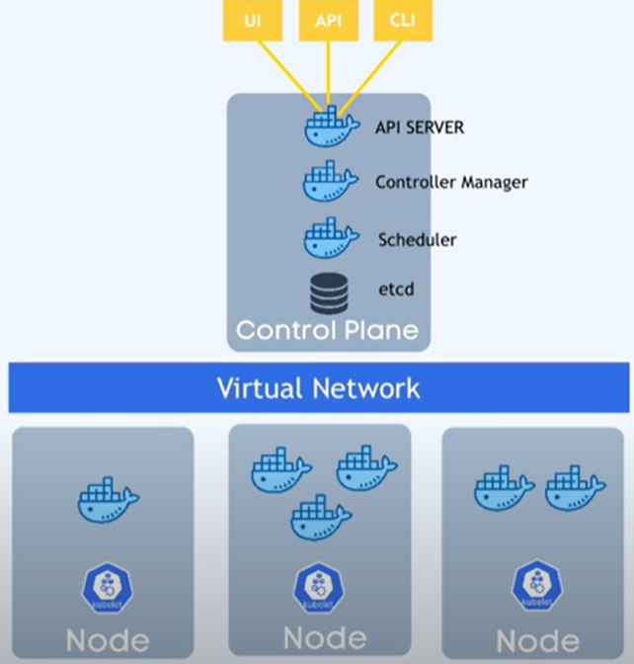
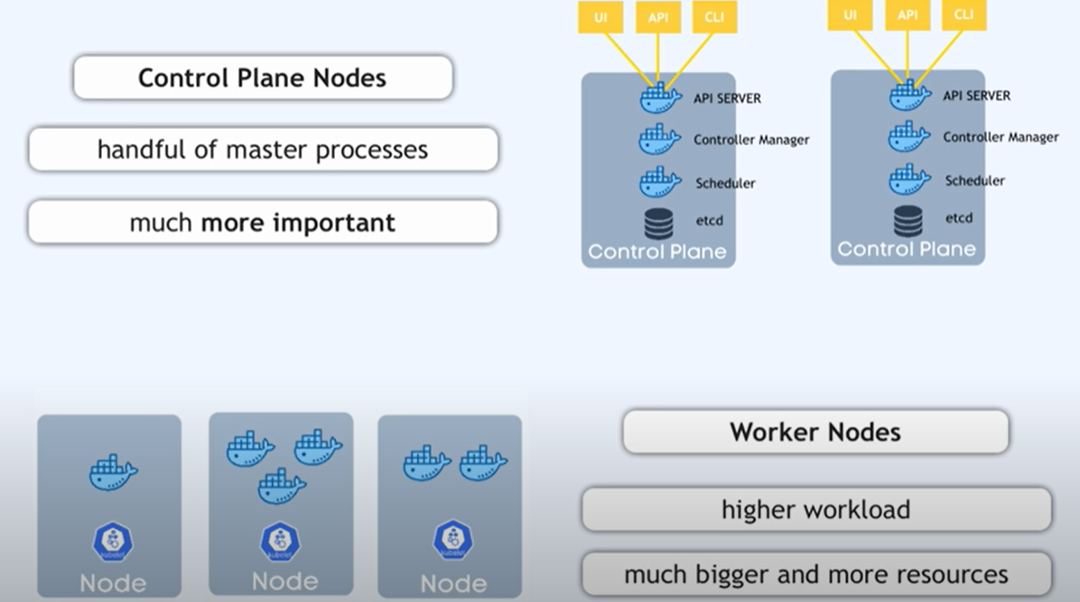
Kubernetes Architecture
Master Control Node
Virtual Network converts the whole into one powerful machine with the sum of all resources
Masters are typically duplicated for reliability

Slide 13
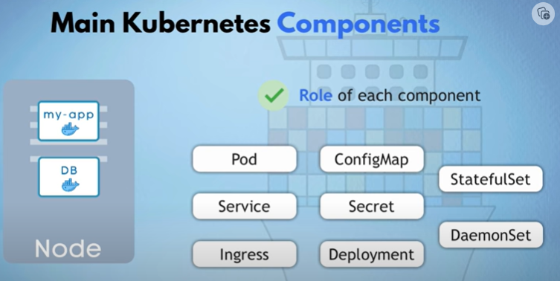

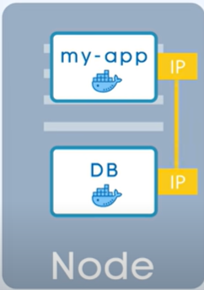
Kubernetes Components
Many components
A basic unit called a Pod is an abstraction over the container in the node
Don’t need to work with container technology (Docker), but work with abstraction
Pod runs one application container
Each pod gets its own (private) IP
However if a Pod dies, its IP address is lost causing issues
Hence another wrapper… Service
Container
Pod

Slide 14
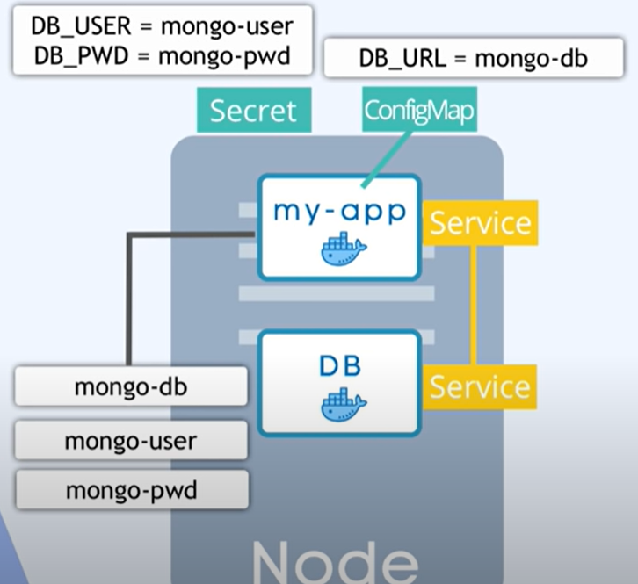
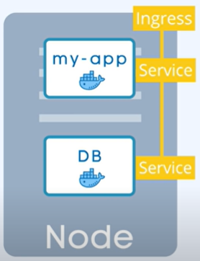
Kubernetes Components
To avoid issues of private and public IPs, there is a set of components called Service and Ingress which enable communication which is secure and reliable
Service helps with exposing stable network endpoints for accessing the Pods
Ingress on the other hand is to expose services outside the cluster and manage HTTP/s routing
ConfigMap for env variables
Secret for sensitive data (passwords/access)

Slide 15
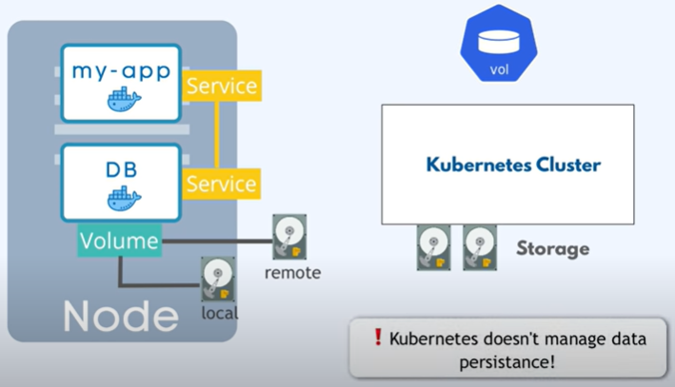
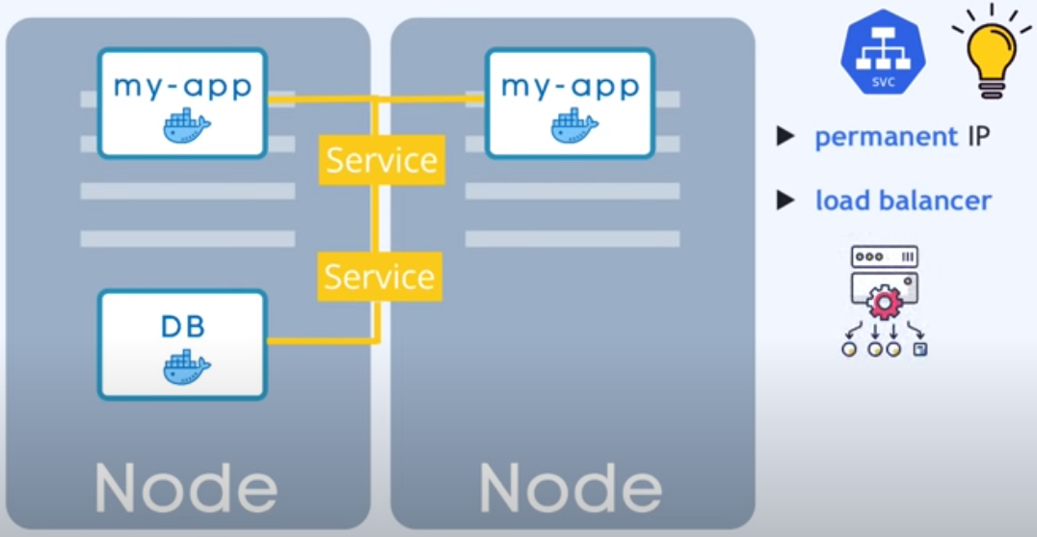
Kubernetes Components
Memory needs to be attached to the Pod in a way that task does not die if the Pod dies.
Kubernetes does not manage data persistence, so you have to manage it
But instead of making duplicates, define a ‘blueprint’ and specify how many replicas you want
That is called ‘deployment’
An abstraction on top of Pods!
DB not through deployment… ☺
No DB duplication?

Slide 16
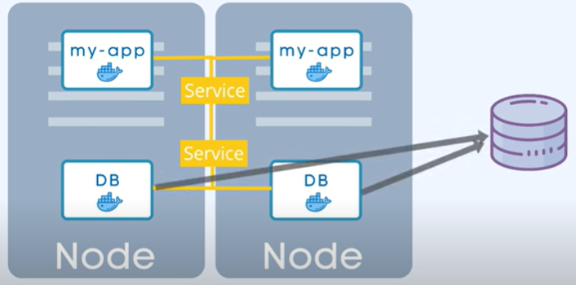
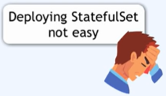
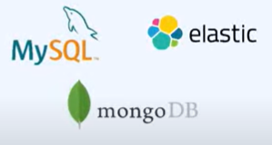
Kubernetes Components
Issues of data consistency can occur!
Often the DB is hosted outside of the Kubernetes cluster due to this
Statefulset (sts) using external databases is useful

Slide 17
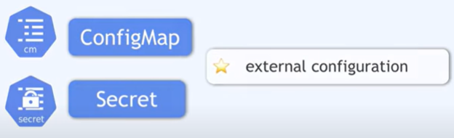

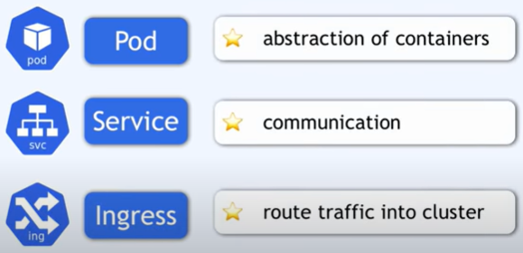
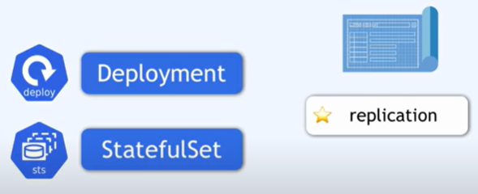
Kubernetes Components summary
Number of components, but they all work together to help make a powerful Kubernetes clusters

Slide 18
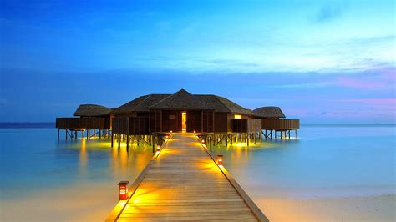
Next class
More NoSQL tools and frameworks!
Final Project progress
Read articles and review videos (if any) posted on Canvas
Come prepared to discuss and work in teams

Slide 19
What questions may I answer before we conclude …
All questions are good questions

